Slide 1
DSP intro

Slide 2
What is DSP?
The world of science and engineering is filled with signals: images from remote space probes, voltages generated by the heart and brain, radar and sonar echoes, seismic vibrations, and countless other applications.
Digital Signal Processing (DSP) is the science of using computers to understand these types of data. This includes a wide variety of goals: filtering, speech recognition, image enhancement, data compression, neural networks, and much more.
DSP is one of the most powerful technologies that will shape science and engineering in the twenty-first century. Suppose we attach an analog-to-digital converter to a computer, and then use it to acquire a chunk of real world data. DSP answers the question: What next?

Slide 3
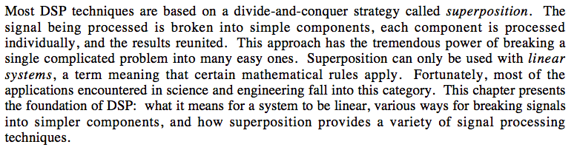
Linear Systems

Slide 4
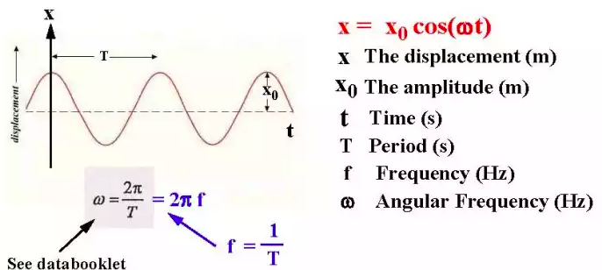
Definitions: Amplitude & Period
Continuous-time sine wave signal
x Amplitude

Slide 5
Analog, Discrete or Digital ?
Analog signal → Sample → Discrete signal → Quantize → Digital signal
Need AN “Anti-aliasing filter” before sampling
Also needed before downsampling a digital signal.

Slide 6
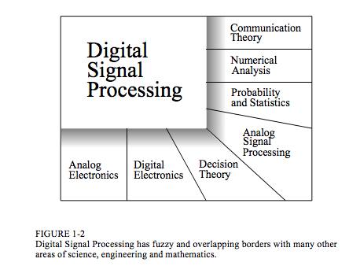

Slide 7
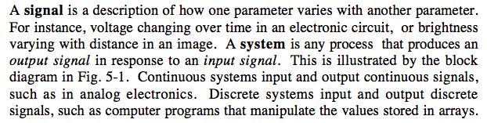
Systems & Signals
System
Input signal
output signal
x[n] → system → y[n]
System transforms input x[n] into output y[n]
Every system can be thought of as a filter, described by a transfer function, h[n]
Later we will discuss convolution, represented by ‘*’
y[n] = x[n] * h[n]

Slide 8
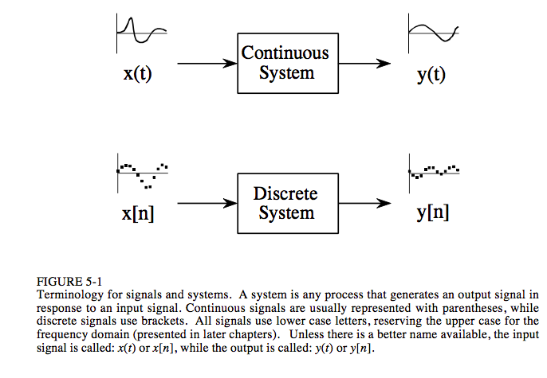
Terminology

Slide 9
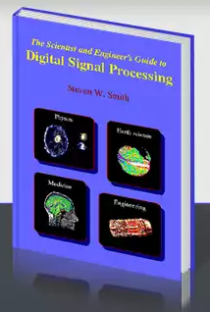
Smith: The Scientist and Engineer's Guide to Digital Signal Processing
PDFs of each chapter available from:
http://dspguide.com/
I will likely assign you readings from this book and base my lecture material on it.

Slide 10
Why understand systems?
design a system to remove noise in an electrocardiogram
sharpen an out-of-focus image
remove echoes in an audio recording
measure distortion, interference
Understand data received from a radar or sonar system
The problem is to find the system that changes the transmitted signal into the received signal.
At first glance, it may seem an overwhelming task to understand all of the possible systems in the world. Fortunately, most useful systems fall into a category called linear systems. This fact is extremely important. Without the linear system concept, we would be forced to examine the individual characteristics of many unrelated systems.

Slide 11
Sinusoidal fidelity
An important characteristic of linear systems is how they behave with sinusoids, a property called sinusoidal fidelity:
If the input to a linear system is a sinusoidal wave, the output will also be a sinusoidal wave, and at exactly the same frequency as the input.
Sinusoids are the only waveform that have this property. For instance, there is no reason to expect that a square wave entering a linear system will produce a square wave on the output.
Although a sinusoid on the input guarantees a sinusoid on the output, the two may be different in amplitude and phase, e.g. a circuit can be described by its frequency response: graphs of how the circuit's gain and phase vary with frequency.

Slide 12
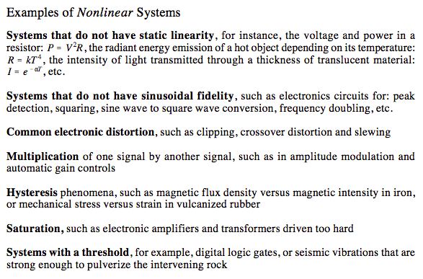
Examples of non-linear systems

Slide 13
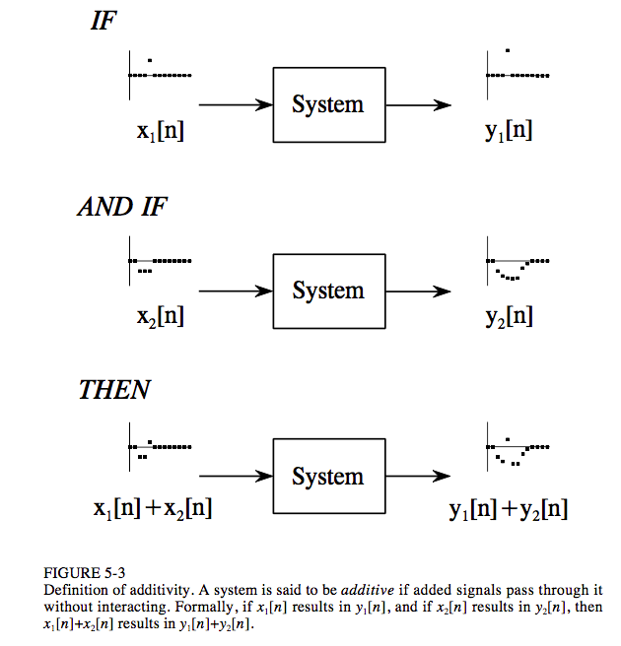
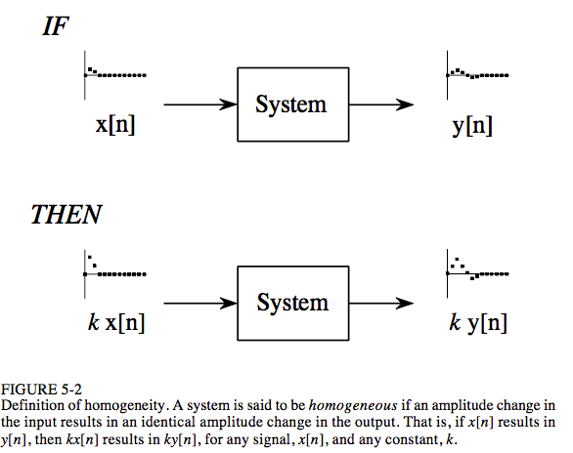
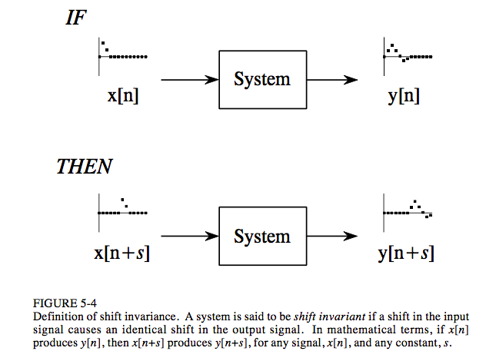
What makes a system linear?
homogeneity
additivity
shift invariance

Slide 14
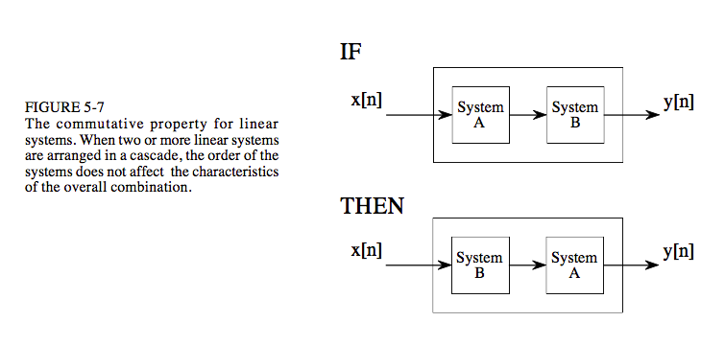
LTI systems are commutative: order does not matter
Imagine a circuit composed of two stages, one for amplification, and one for filtering. Which is best, amplify and then filter, or filter and then amplify? If both stages are linear, the order doesn't make any difference and the overall result is the same.

Slide 15
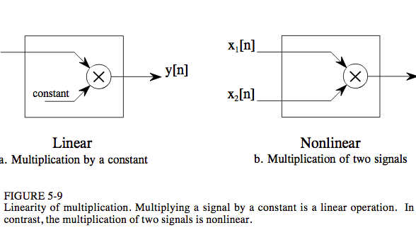
Multiplication by a constant is linear, but by another signal is not

Slide 16
Superposition: the Foundation of DSP
Signals can only be combined is by scaling (multiplication of the signals by constants) followed by addition. Otherwise, system no longer linear.
This process of combining signals through scaling and addition is called synthesis.

Slide 17
Superposition: the Foundation of DSP
Signals can only be combined is by scaling (multiplication of the signals by constants) followed by addition. Otherwise, system no longer linear.
This process of combining signals through scaling and addition is called synthesis.
Decomposition is the inverse operation of synthesis, where a single signal is broken into two or more additive components.
There are infinite possible decompositions for any signal (Fourier analysis gives us one possibility).

Slide 18
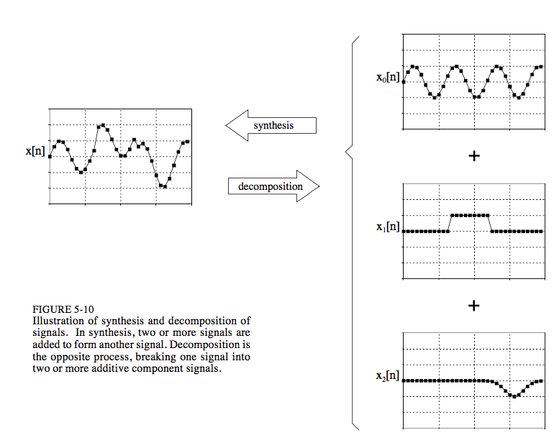
Synthesis & decomposition

Slide 19
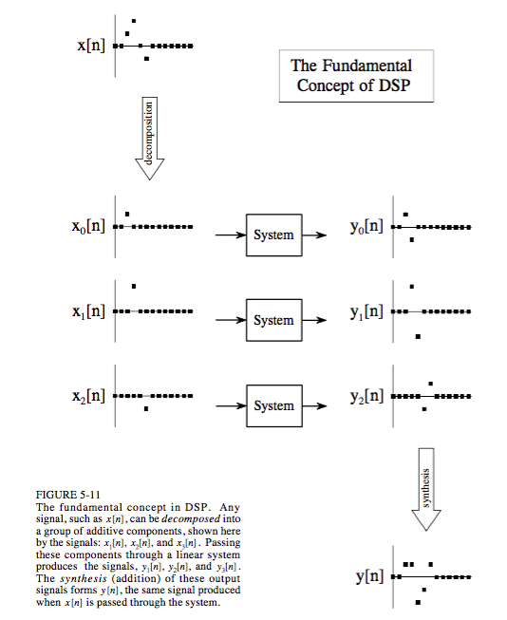
Fundamental concept of DSP: Superposition
If system H transforms input signal x[n] into output signal y[n]
Then if we decompose x[n] into x1[n], x2[n], x3[n] and pass each of those individually through H, producing y1[n], y2[n], y3[n]
Then y1[n] + y2[n] + y3[n] = y[n]
So instead of trying to understand how complex signals are modified, we only need to know how simple signals are modified!

Slide 20
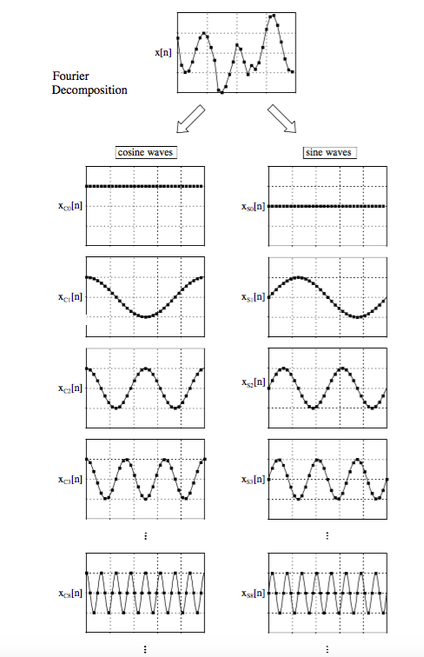
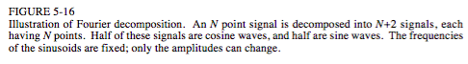
Fourier decomposition

Slide 21
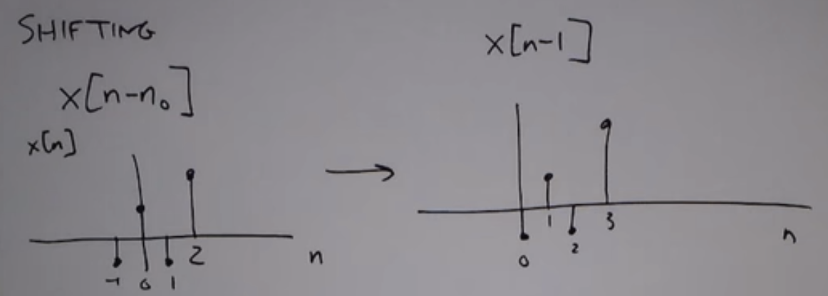
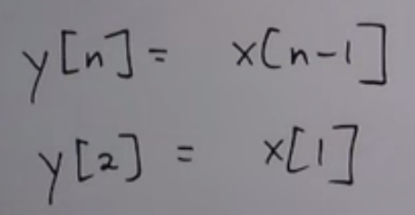
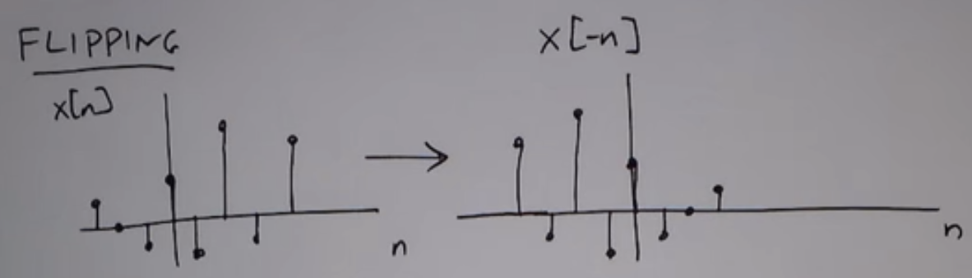
time-shifting & time-reversal
revx = fliplr(x)

Slide 22
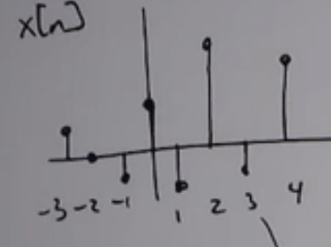
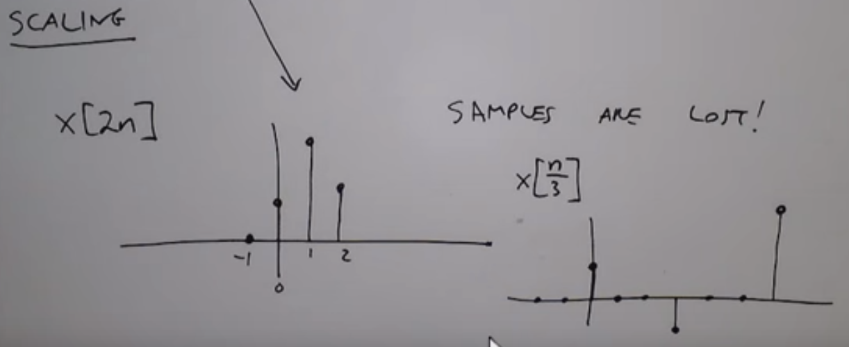
Time scaling (changing frequency)

Slide 23
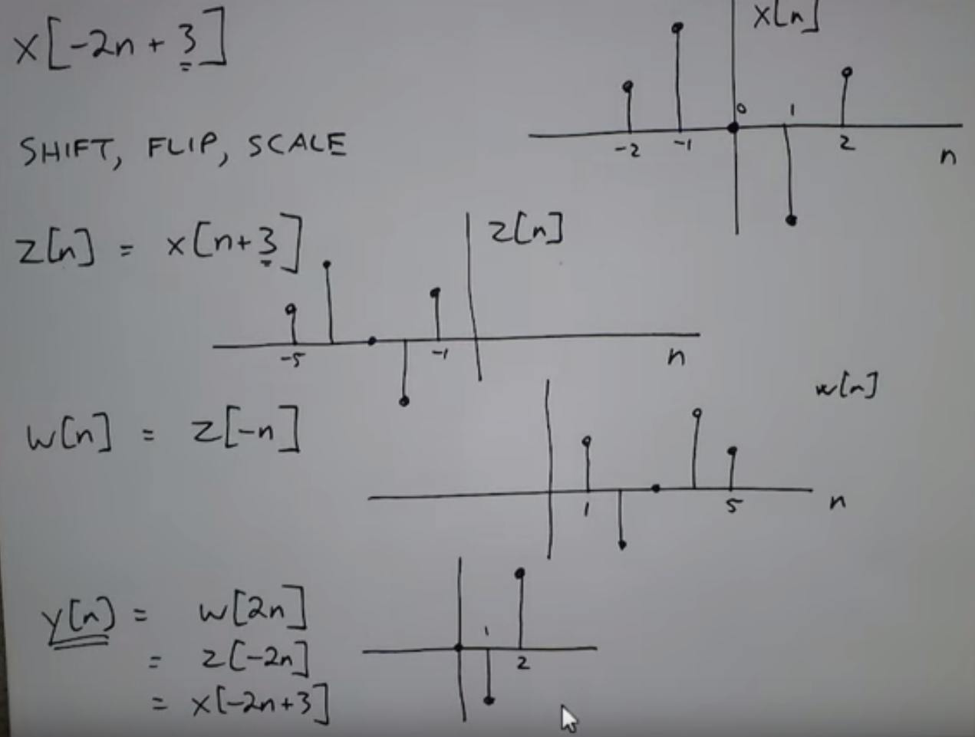
Combining time operations:
What is x[-2n + 3] ?
Key is:
Shift
Flip
Scale

Slide 24
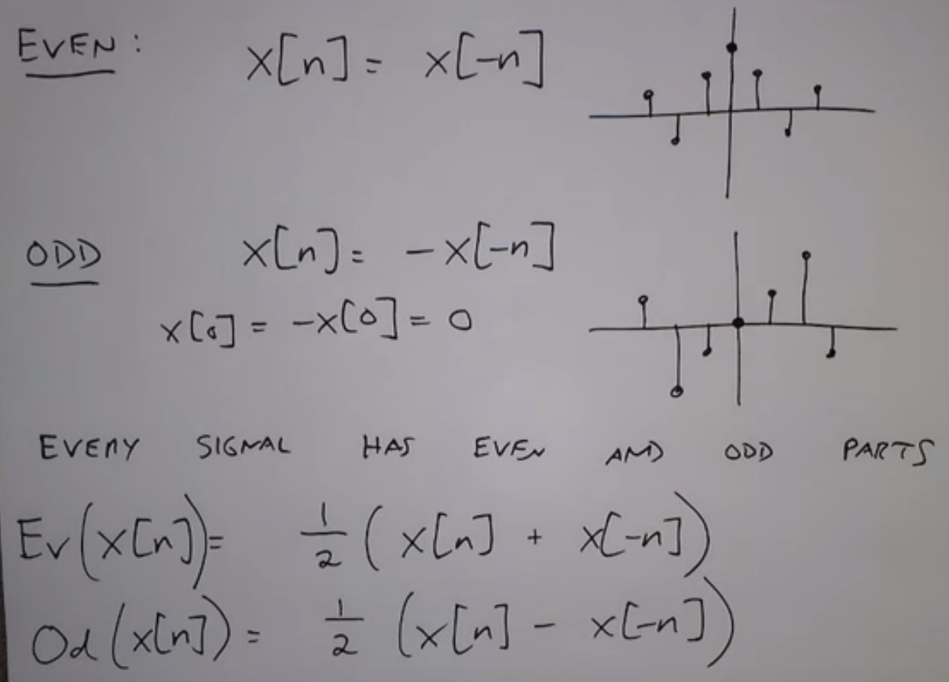
Signals can be broken into Even and Odd components
MATLAB:
reversex = fliplr(x)
evenx = (x + revx)/2
oddx = (x – revx)/2

Slide 25
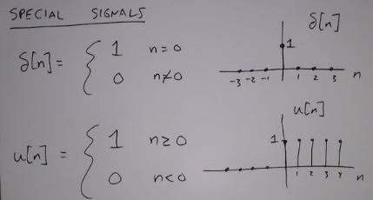
Special signals: unit impulse & unit step functions
← Delta function
← Heaviside function

Slide 26
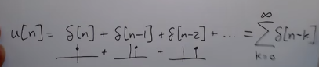
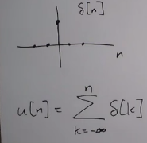
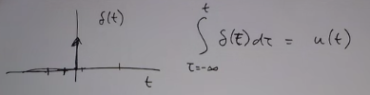
unit step is running sum of unit impulse
Compare with: Continuous-time step function

Slide 27
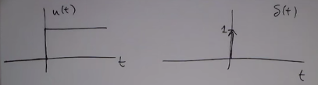
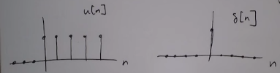
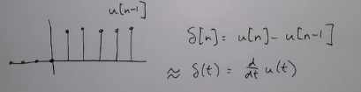
Unit impulse is difference of two unit steps
Continuous time
Discrete time

Slide 28
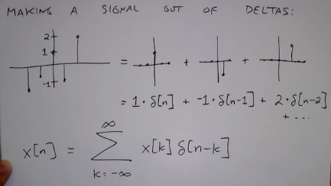
You can make any signal of out delta functions

Slide 29
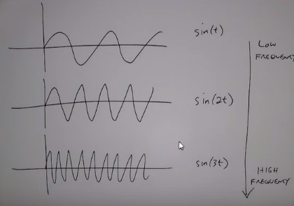
Compose signal from sinusoids
Basis of Fourier Series/Transforms

Slide 30
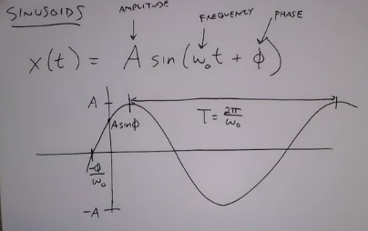
Sinusoids
Sine waves:
Mains AC
Signal generators
Oscillations in LRC circuits
Vibrations, resonance: e.g pendulums, musical instruments, bridges
electromagnetic waves

Slide 31
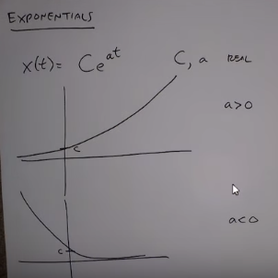
Exponentials (real)

Slide 32
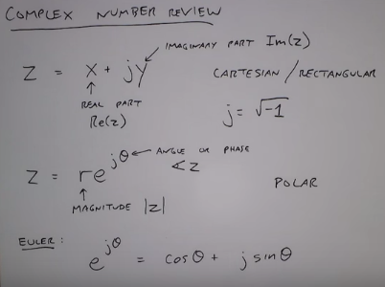
Complex number review

Slide 33
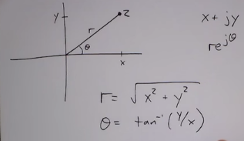
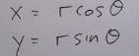
Complex numbers
“complex plane” or
“Argand diagram”

Slide 34
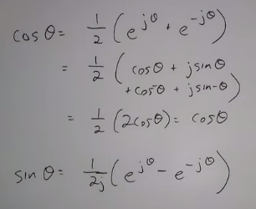

Slide 35
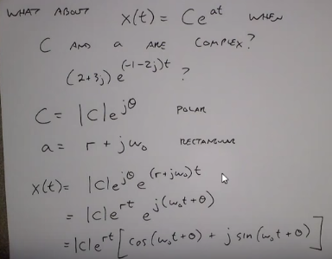
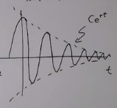
Exponentials (complex) and relation to sinusoids

Slide 36
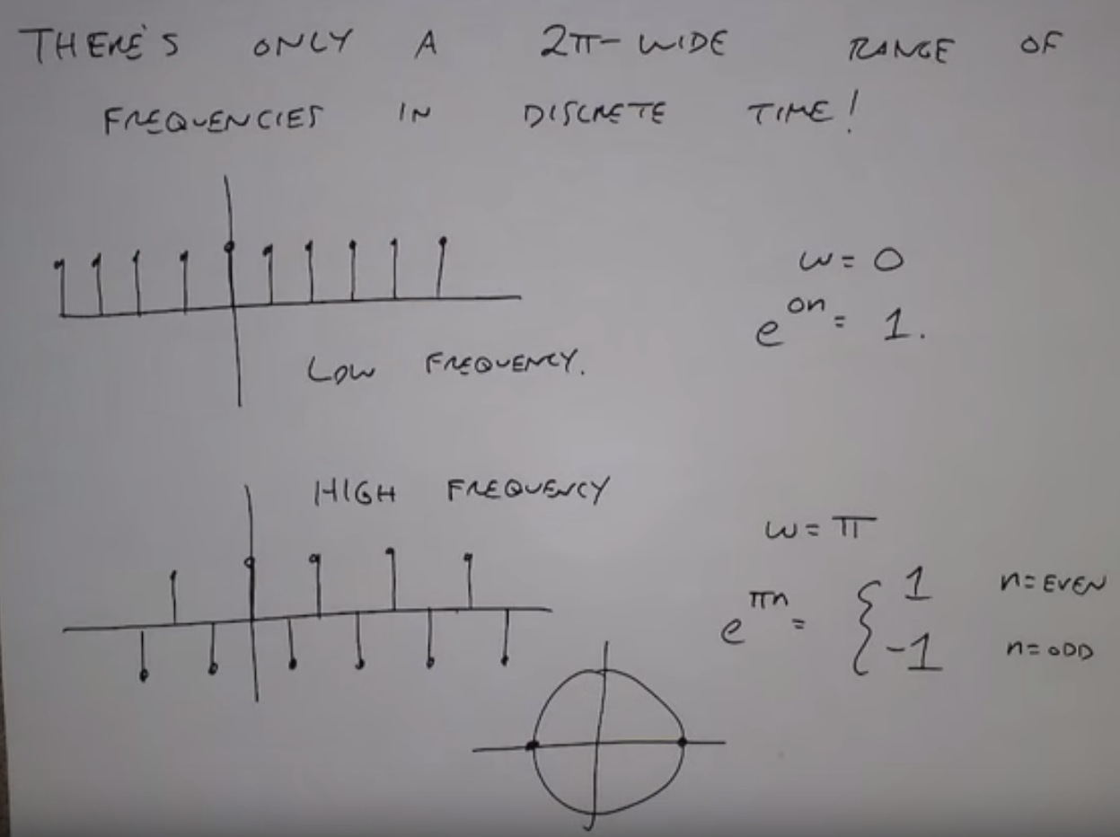

Slide 37
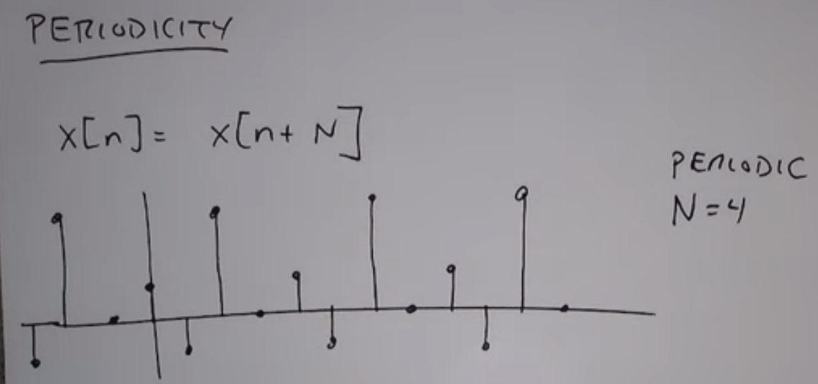
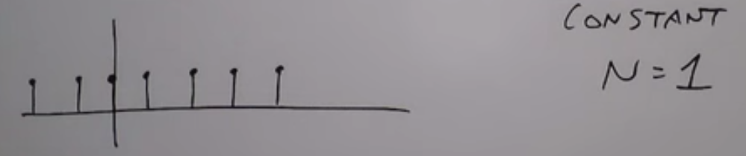
Periodicity
Constant (DC, 0 Hz) signal is periodic with a sampling interval of 1T
For analog signal, T becomes 0, so

Slide 38
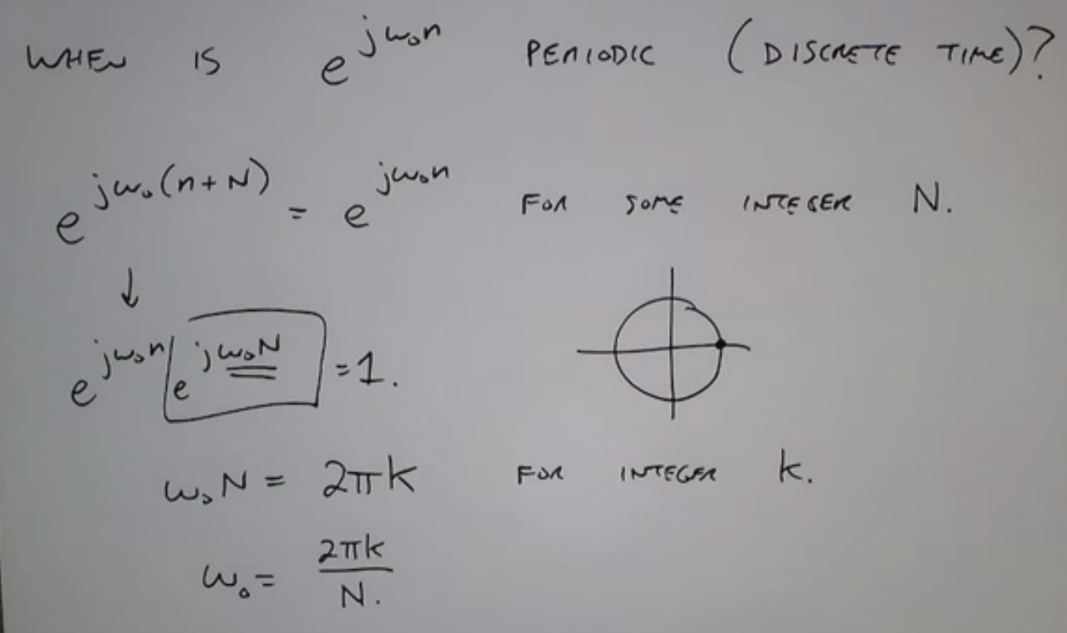
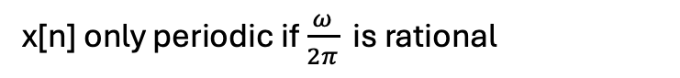
Sinusoids are not generally periodic in discrete time
x[n] only periodic if $\frac{ω}{2π}$ is rational

Slide 39
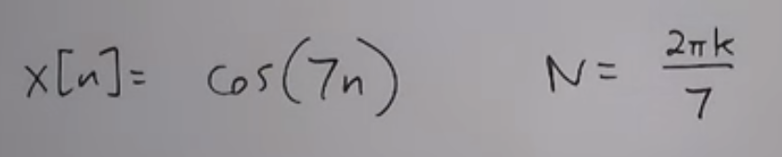
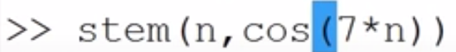
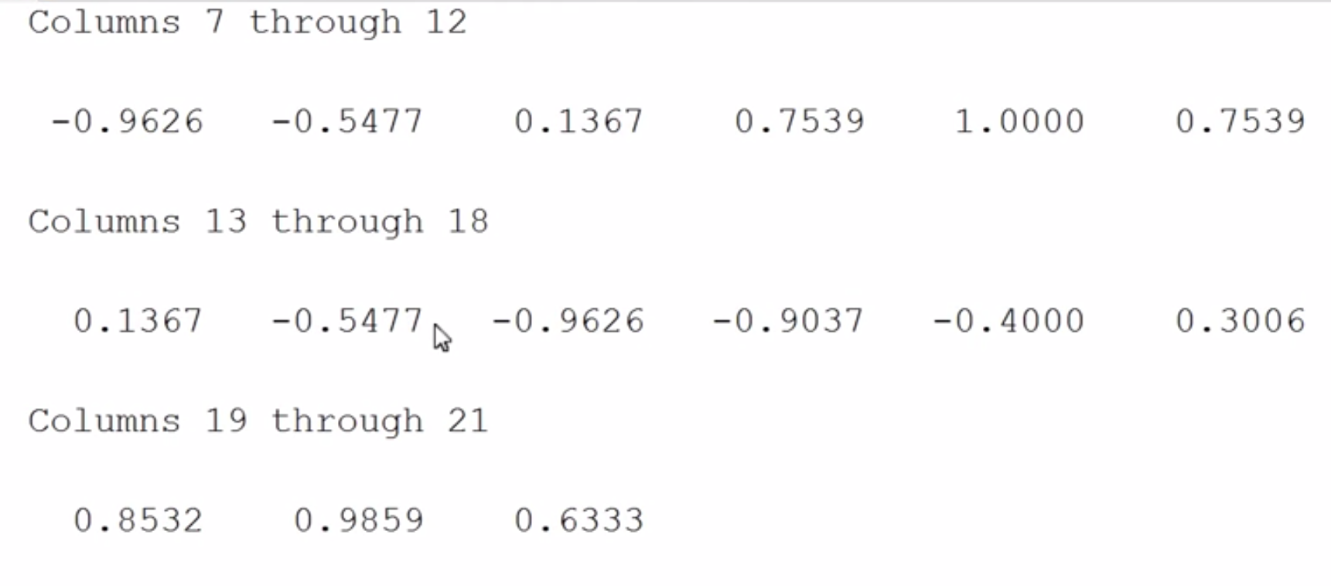
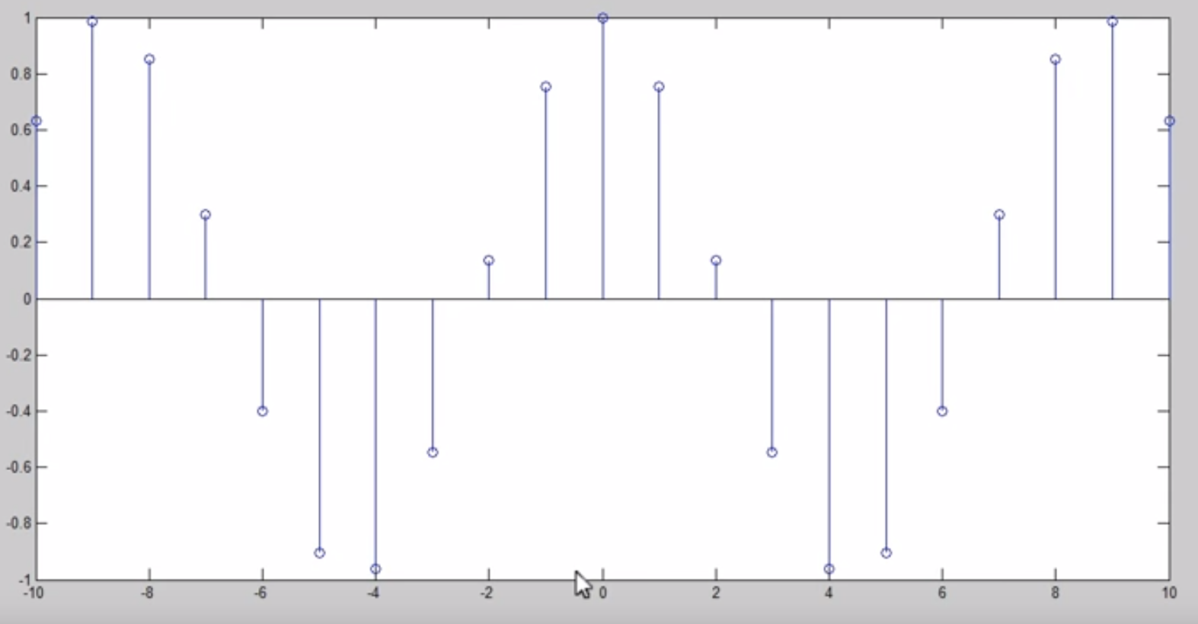
Non-periodic

Slide 40
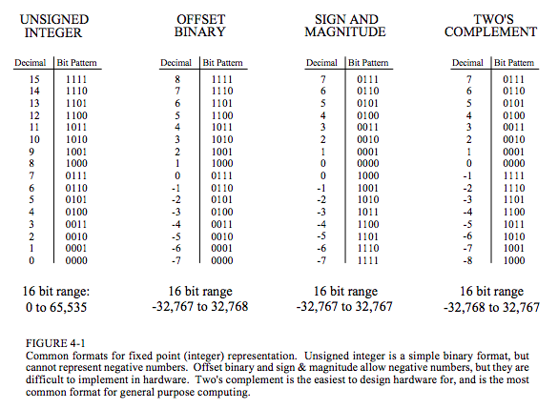
Computer Numbers: Integers

Slide 41

Computer numbers: floating point (reals)

Slide 42


Slide 43

Summary
Digital Signal Processing (DSP) is the science of using computers to understand signals and the linear systems that modify them.
DSP techniques are based on superposition, which assumes linear, time-invariant (LTI) systems.
LTI systems are homogeneous, additive, shift-invariant, commutative and have sinusoidal fidelity.
Signals can only be combined by scaling and adding (in that order). This is called synthesis (or composition).
Decomposition is the inverse operation of synthesis, where a single signal is broken into two or more additive components.
There are infinite possible decompositions for any signal (e.g. impulse, step, sine waves, even-odd, interlaced, ...).

Slide 44
Digital signals
Basic operations include: time-shifting, time-flipping (reversal), time-scaling (in that order) – allows us to compute x[-2n+3] if we know x[n]
Special signals are: impulse, step, sine, exponential
Complex exponential (or complex sine) give rise to sine modulated by falling/rising exponential
Discrete-time sinusoids are not generally periodic unless we choose our sample times such that one period is some multiple of our sampling interval, e.g. if sine wave has a period of 10s and we choose T=1s, then this will be periodic. But typically naturally sine waves will have an irrational period, in which case it is hard to choose T.

Slide 45
The two fundamental decompositions
Impulse decomposition (one sample at a time)
Fourier decomposition (one frequency at a time)
The impulse decomposition is the basis of convolution.

Slide 46

(or “unit impulse”)
(or “kernel”)
Unit impulse is zero everywhere except at n=0
Impulse response tells us everything there is to know about a system

Slide 47

Example:
Take a signal, x[n] = -3δ[n-8]
(a=-3 at n=8; a=0 elsewhere)
Response to δ[n] is h[n]
Response to x[n] is y[n]=-3h[n-8]

Slide 48


Slide 49


Slide 50

Length of convolution output
Length(y[n]) = length(x[n]) + length(h[n]) – 1

Slide 51

End effect
At each end of signal there is only partial overlap between x[n] and h[n].
If h[n] has length M, first and last M-1 samples of y[n] are based on less information → transients.
Rule: embed the signal of interest in the middle of your discrete time series
Filtering is convolution

Slide 52




Delta function
Passes the entire signal (all frequencies equally)

Slide 53




Calculus
First difference / Discrete Derivative
Running sum / Discrete Integral
Recurrence relation
(recursion) or difference equation

Slide 54

Low Pass Filters
Adjacent positive values smooth data

Slide 55

High pass filters
High Pass Filters
Spike surrounded by negative values

Slide 56

Causality
Causality
All real systems (e.g. analog electronics) are causal. They cannot respond to future values.
Digital systems(e.g filters) can be non-causal, because data can be stored first, processed later.

Slide 57

Phase linearity
Linearity
ZERO PHASE?
Think of cosine waves / even functions
For all frequency components, phase must be zero, else not symmetrical
LINEAR PHASE
All frequencies shifted by same time, but that means a different number of wavelengths
ZERO PHASE?
Think of cosine waves / even functions
For all frequency components, phase must be zero, else not symmetrical

Slide 58


Properties of convolution
Commutative (order of operations does not matter)
Associative
Distributive

Slide 59

Central Limit Theorem
The result of many random processes tends to have a Gaussian (Normal) distribution

Slide 60

Convolution – by hand, the long way

Slide 61


Slide 62


Slide 63


Slide 64



Correlation
How related to signals are
Typically used for finding one signal within another longer one (matched filtering)
Cross-correlation: correlation between two different signals (can extract delay)
Auto-correlation: correlation between a signal and itself (useful for finding periodicities)

Slide 65


Convolution by hand
h[n]
x[-n]
x[n] = [2 3 -1 7]
x[-n] = [7 -1 3 2] (n=[-3 -2 -1 0])
h[n] = [-1 10 4]
y[n] = [-2 17 39 -5 66 28]
y[n]
In MATLAB:

Slide 66
3.3 The z-transform

Slide 67



z-Transform: time-shifting
Take a signal:
A[n] = [a₀ a₁ a₂ … a_{N-1}]
The z-transform is the polynomial:
Multiplying by z is the same as time-shifting by 1 sample:
because this is now the signal:
[0, a₀ a₁ a₂ … a_{N-1}]
In general, multiplying by z^{k} delays a signal by k-samples.
(z is just a symbol that represents a complex number, so a z-transform just means “complex transform”)
⁺¹

Slide 68






Multiplying two z-transforms
This is just the z-transform of the time sequence c[n] where:
Which is identical to the convolution formula:
Multiplying the z-transforms (polynomials) of two signals is the same as convolving them.

Slide 69
Dividing two z-transforms
B(z) = C(z) / A(z)
This is the inverse process of convolution: deconvolution

Slide 70

Transfer function: poles and zeros
Since a z-transform is a polynomial, it has roots. In general a polynomial of order N has N complex roots, and can be factored into:
So we can also write the ratio of two z-transforms as:
This means that r(z) will become 0 when z is any of z₀, z₁, …, z_{N-1}
and that r(z) will become ∞ when z is any of p₀, p₁, …, p_{M-1}
The complex numbers z₀, z₁, …, z_{N-1} are the “zeros” of the function, r(z)
The complex numbers p₀, p₁, …, p_{M-1} are the “poles” of the function, r(z)
r(z) is called the discrete transfer function. It is the z-plane analog to the impulse response (which is defined for the time domain).

Slide 71

Pole-Zero Plot
The unit circle
|z|=1
or
z = e^{-jω}
where ω ranges from 0 to 2π

Slide 72
Where is this going: filters
Any filter can be described by:
poles and zeroes (z-domain)
impulse response (time domain)
frequency response function (Fourier/frequency domain)
For continuous-time signals we use the Laplace transform / s-domain.
For discrete-time signals we use the z-transform / z-domain.
A perfect seismometer would respond equally to all frequencies. This is impossible. So seismometers are described by their transfer functions, given as a set of poles and zeros (e.g. SAC pole-zero files). From these poles and zeros we can work out the frequency response function (e.g RESP files).
Since seismometers deal with analog signals, we use Laplace transforms, not z-transforms. But for all the digital filters you will use (on a computer) it is more useful to know z-transforms.

Slide 73
What is next?
The z-transform (i.e. discrete complex transform) is the discrete version of the Laplace Transform.
The Discrete-Time Fourier Transform (DTFT) is the special case of the z-transform evaluated along the unit circle, z=e^{-iw}, i.e. a set of complex sinusoids.
The Discrete Fourier Transform (DFT) is a sampled version of the DTFT.
The Fast Fourier Transform (FFT) is an algorithm used to compute the DFT. This is what we use to do Fourier decomposition (decompose a complex signal into a discrete sum of different complex exponentials).
These, and their relation to Fourier Series (continuous periodic signals) and Fourier (Integral) Transform (continuous non-periodic signals), will be covered in detail later.

